Slide 1
Enterprise Architecture
Grow, Transform
Deven Gengan
Enterprise Architect – Standard Bank Group

Slide 2
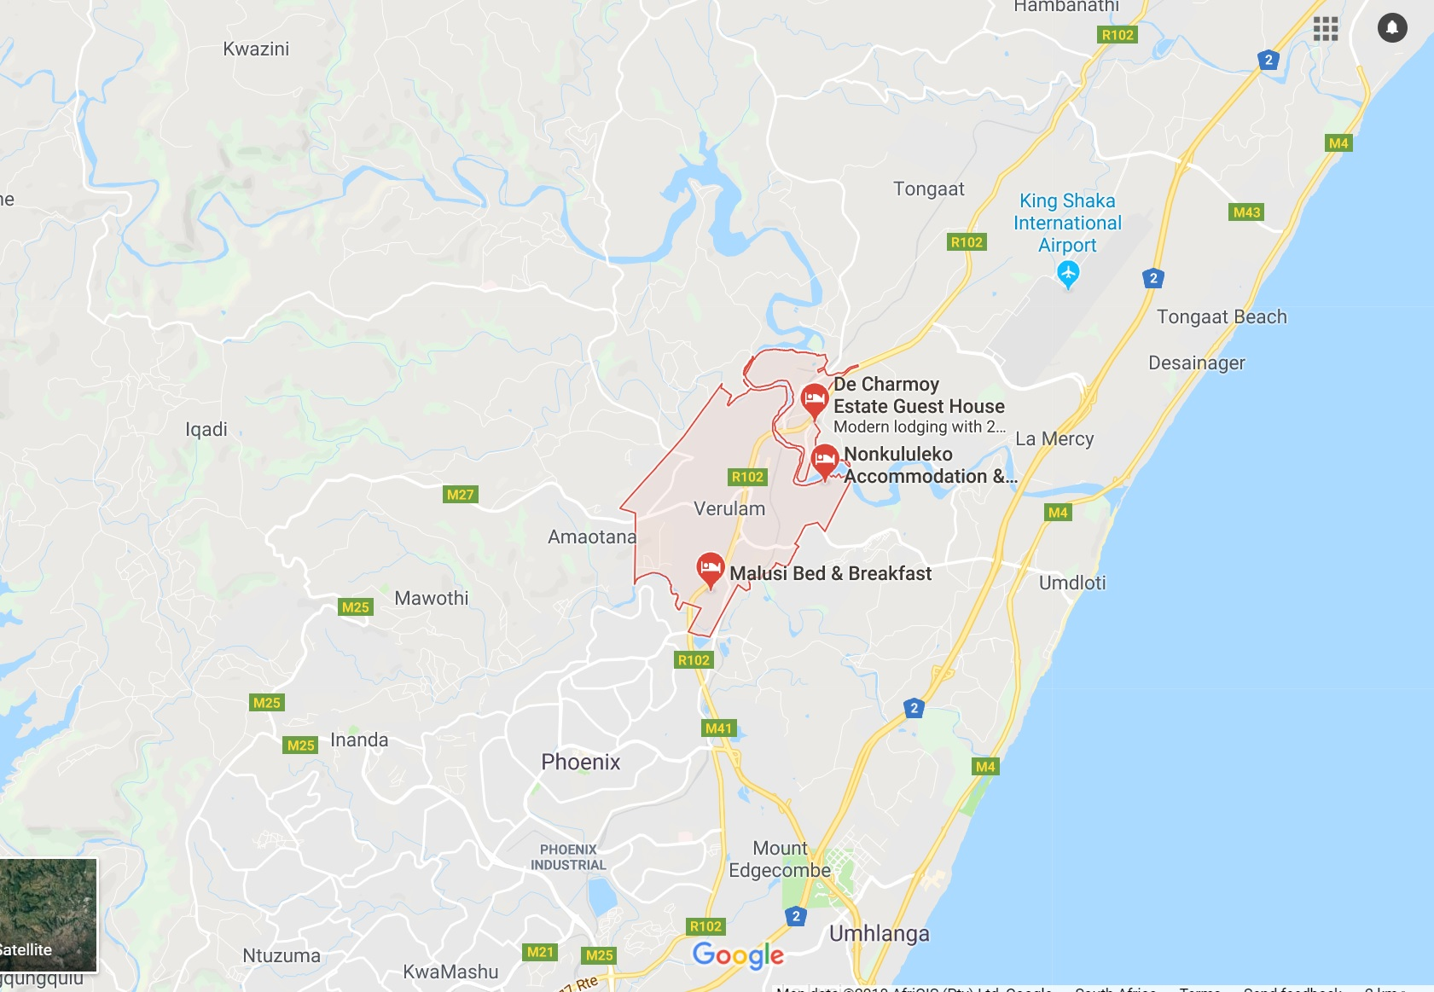

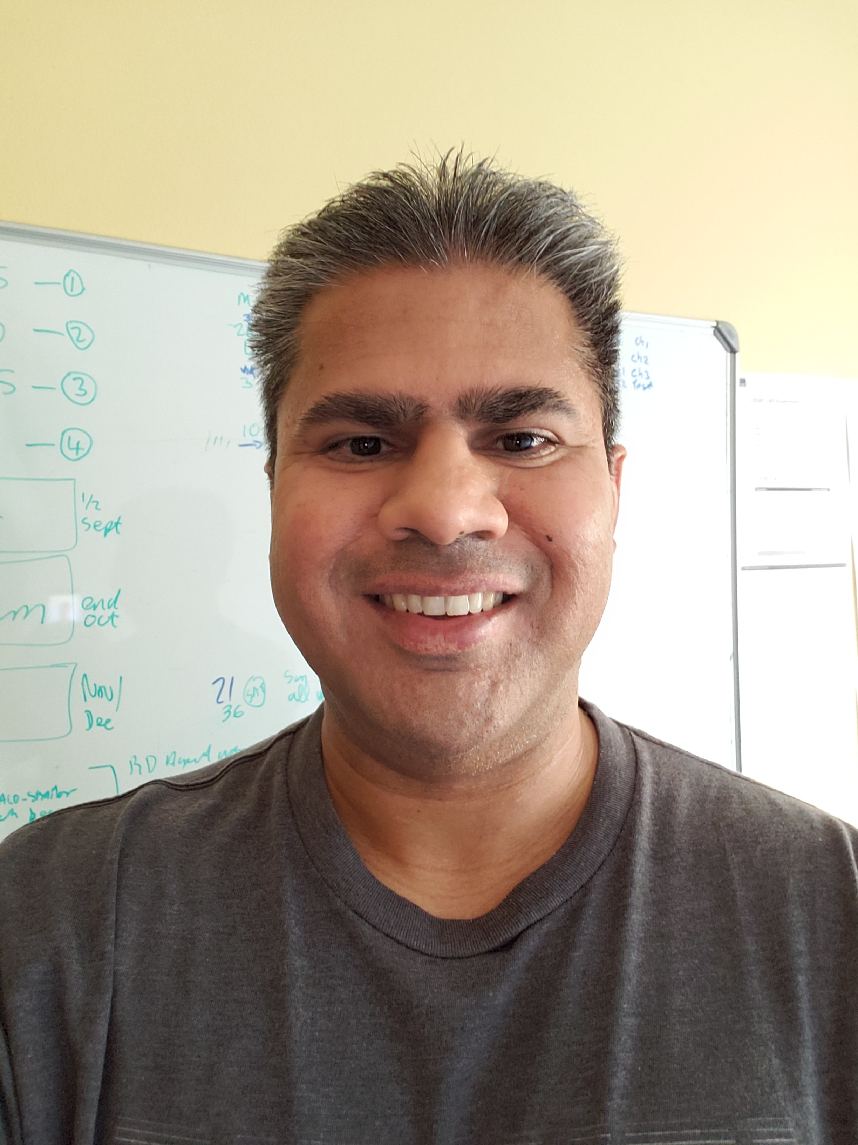




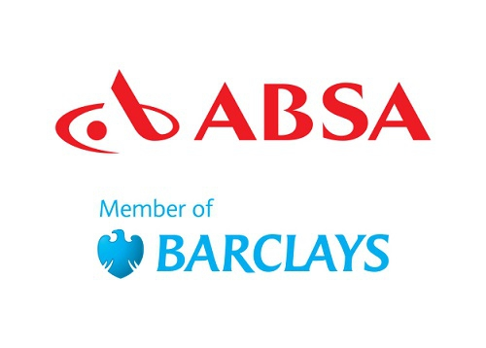



Portrait Of An Enterprise Architect
Before
After

Slide 3
The Growth Mindset

Slide 4
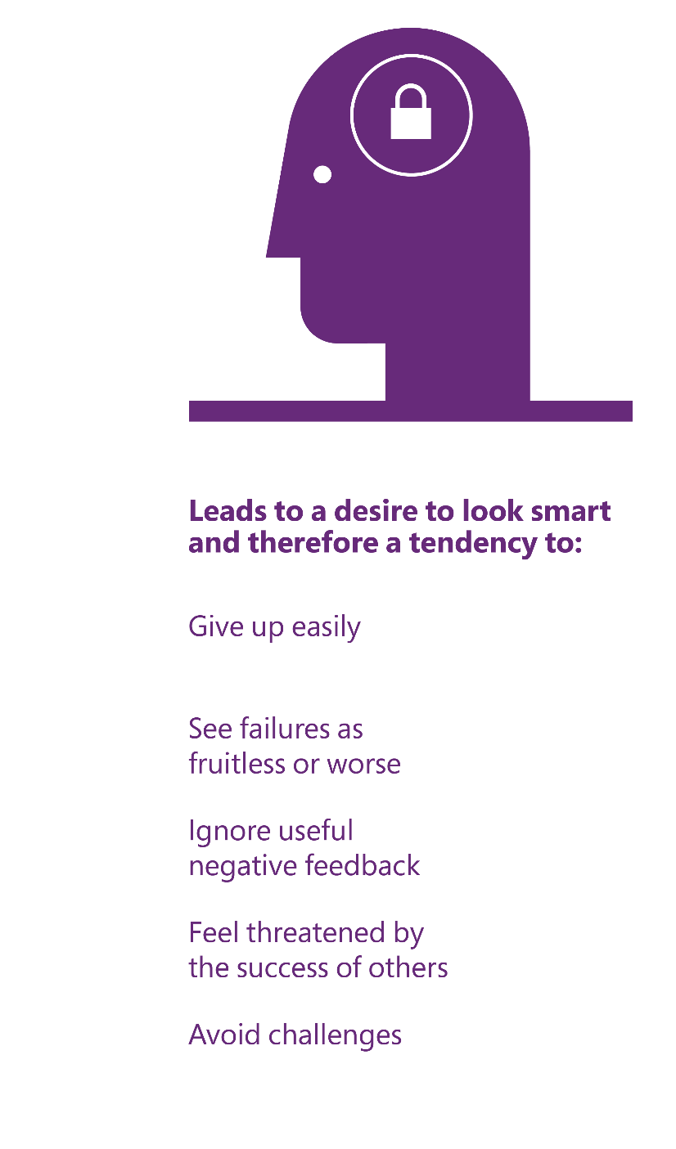
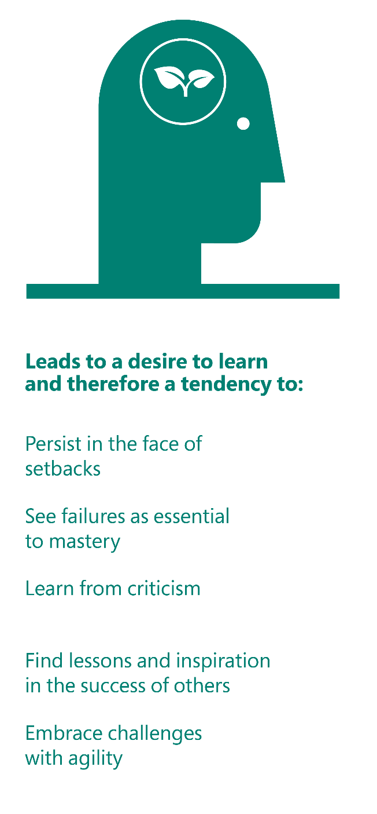
Video: understanding mindset
Fixed mindset:
ability is static
Growth mindset:
ability can be developed
Play Video
must be in ‘Presentation Mode’ to Play video

Slide 5

How do mindsets show up in us & others?
Fixed mindset:
ability is static
Growth mindset:
ability can be developed
Fixed Mindset:
ability is static
Growth Mindset:
Ability can be developed
Our mindsets can be applied to any ability and are flexible depending on context.
What is one non-work-related example of when I exercised a fixed mindset?
“I tried getting into swimming, but I think I am just not a natural. I think even if I swam a million laps, I would never get any better.”
What is one non-work-related example of when I exercised a growth mindset?
“I recently started taking cooking classes, and I feel I can greatly improve my cooking skills if I keep practicing on my family.”
What is one personal example of when I exercised a fixed mindset?
I tried public speaking once, but I think I’m just not a natural. I think even if I did it more, I’d never be good at it.
What is one personal example of when I exercised a growth mindset?
I recently started working out; what a pain, at first! I knew if I kept it up, I’d get better. Now, I’m setting bigger goals!

Slide 6
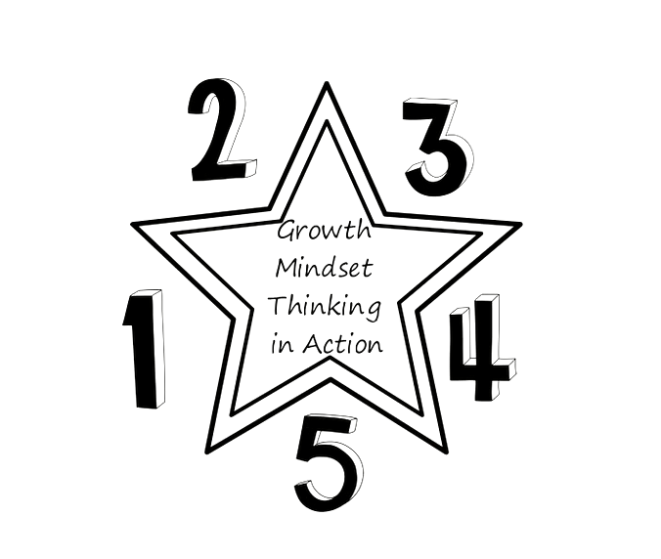
Video: growth mindset thinking in action
Focus on progress over time
Experiment
Learn from others
Be self-aware
Play Video
must be in ‘Presentation Mode’ to Play video
Choose the right words

Slide 7
Making Magic Here

Slide 8
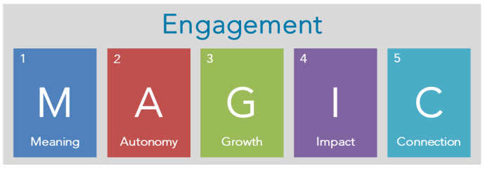
Are you engaged or just satisfied ?
What I do must have some significance to me; it must mean something to me personally, and on more than just a surface level. To me, my work is something of value—something of worth. If I’m only focused on a paycheck, I am willing to put in as much work as is commensurate with the paycheck. However, when my work has meaning to me, what I do has greater purpose
Do I have the freedom and empowerment to perform my job in a way that I do best? Autonomy involves a degree of self-governance. It allows me, as an individual, to create or shape my role and environment in a way that is best for me and for the organization.
There was a time years ago when one could maintain a base set of skills or level of development, and that base could carry that individual throughout his or her career. However, our internal speed of change and growth must match (or exceed) the external rate of change. Particularly with rising generations, the ability to develop, grow, and progress in a job provides challenge and excitement that benefit not only the individual but also the company.
When an employee puts in his or her all, yet has little impact on the organization’s or team’s success, engagement is difficult to cultivate. On the other hand, if what I am doing is making an impact, I am often willing to go through tough times if I have hope of making an impact. This is also where recognition and feedback fit in. I need to understand what kind of impact I am having; feedback from a customer, peer, boss, etc., will help me understand that level of impact.
This factor is clear throughout many of our employee engagement surveys. Quite often, one of the highest-scoring questions on the engagement survey is related to a version of the following question: “I like the people I work with.” Employees need to feel a connectedness to those around them. Similarly, my connection to the organization-will often dictate my level of commitment.
Source: https://www.decision-wise.com/5-keys-of-employee-engagement-magic/

Slide 9
References

Slide 10
So worth your while !!!
Mindset, Carol S Dweck
A Fearless Heart, Thupten Jinpa
Hit Refresh, Satya Nadella
Resilient, Rick Hanson
It Doesn’t Have to be Crazy at Work, Jason Fried

